Slide 1


Slide 2
MISSION
Connect the world's professionals to make them more productive and successful.
VISION
Create economic opportunity for every member of the global workforce

Slide 3










WHY LINKEDIN?
LinkedIn is the world's largest professional network with millions of members.
What does LinkedIn help you do?
Learn new skills and share professional insights
Build your brand
Grow your network
Land your dream job!

Slide 4
How do you build your brand?
By building your LinkedIn Profile
Top Card (Profile Picture, Professional Headline)
Summary
Background (Experience, Education, Volunteer Experience)
Skills
Accomplishments (Certifications, Projects, Awards etc)

Slide 5

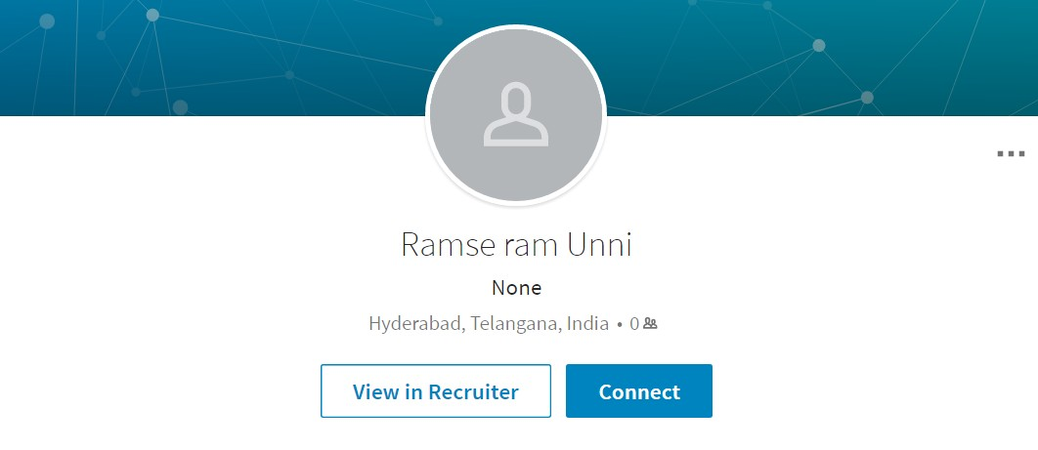
What makes a good Top Card?

Slide 6
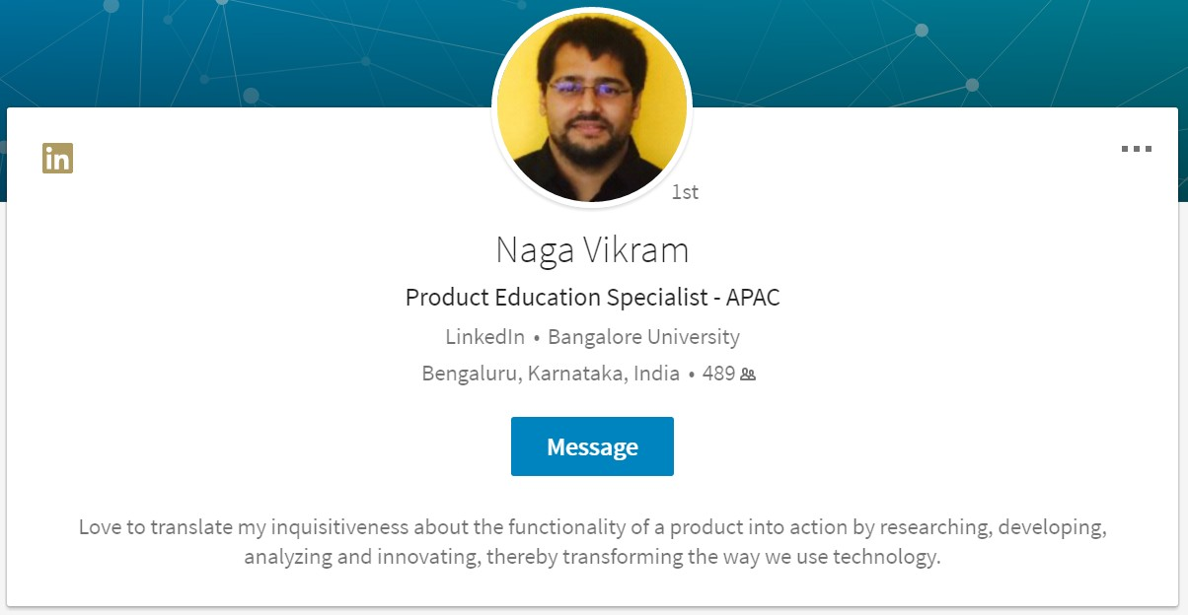
TOP CARD
Along with your photo, your headline is
the first thing people see on your LinkedIn profile.
Use this area to speak directly to your target audience, including phrases or
keywords they might be using to find you.

Slide 7
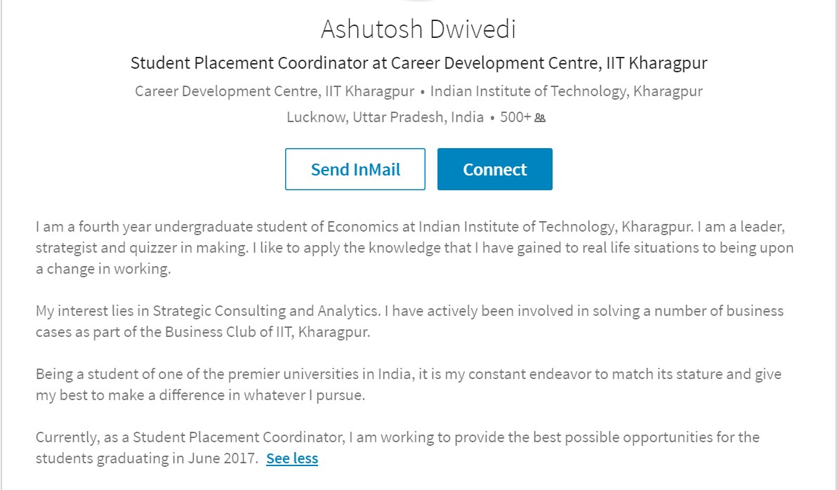

SUMMARY
Summary is your opportunity to talk about yourself both personally and professionally.
Make it count!
Don’t waste the opportunity

Slide 8
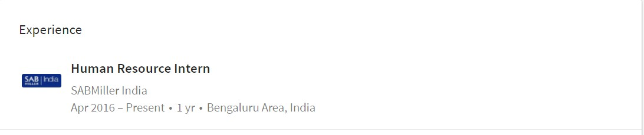
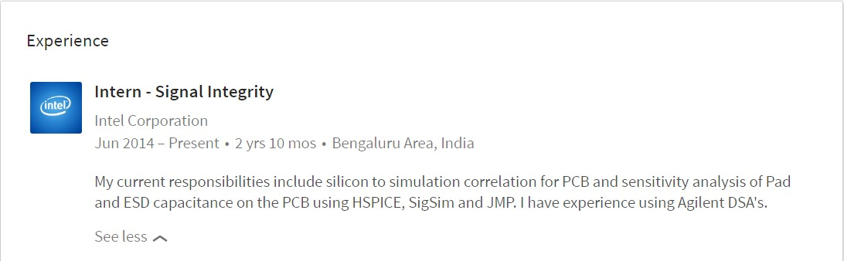
BACKGROUND: EXPERIENCE
This is where your professional experience goes – Full time work experience or Internships
Which one do you think is a better profile?
Profile 1
Profile 2

Slide 9
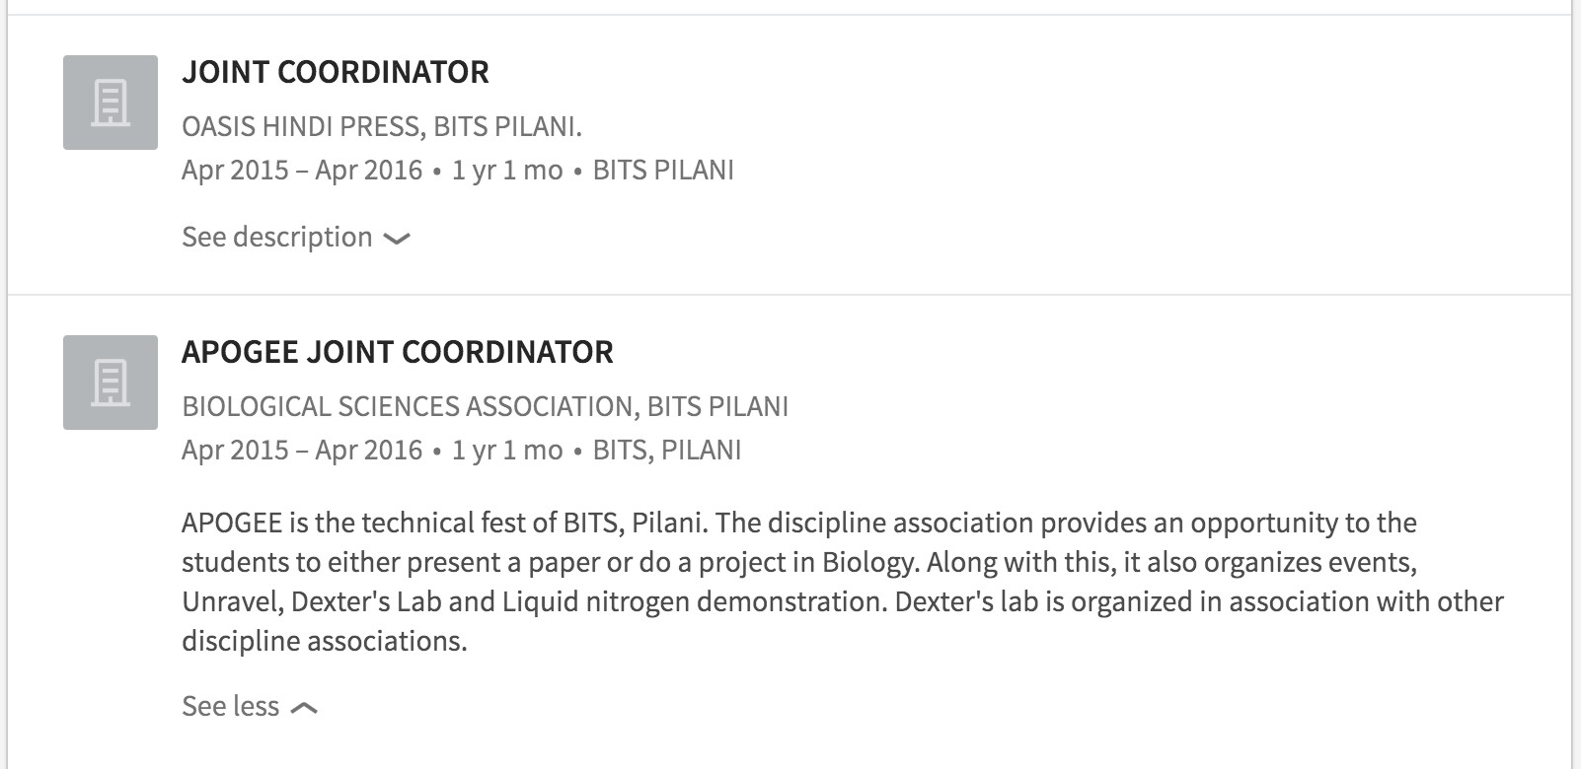
BACKGROUND: EXPERIENCE
This is NOT where you put positions held in college or campus clubs.

Slide 10
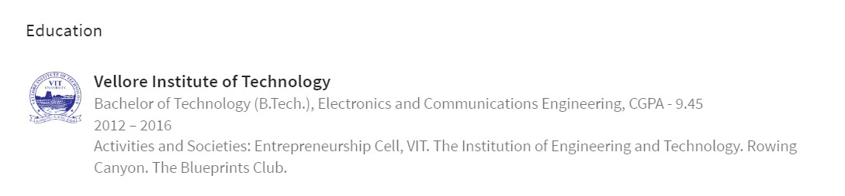
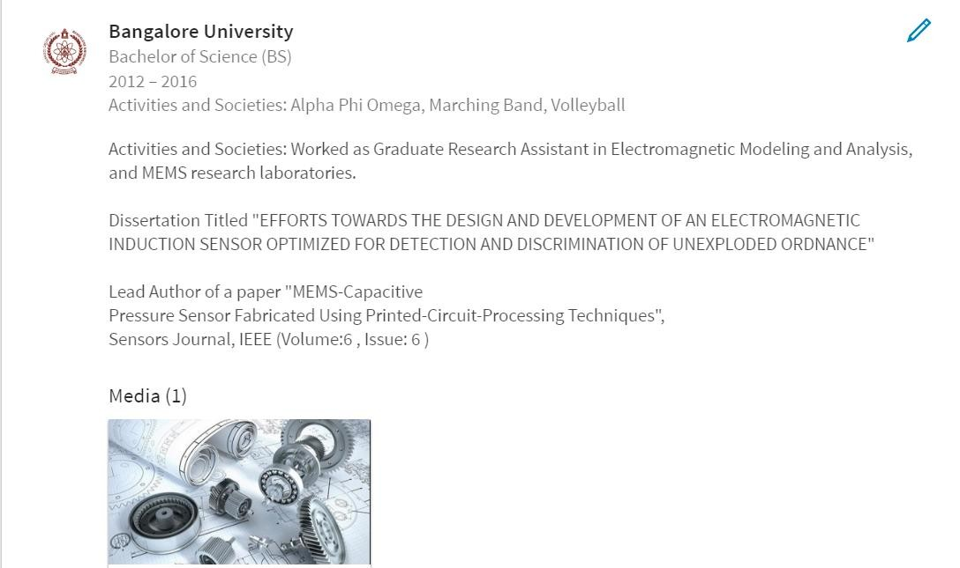
BACKGROUND: EDUCATION
Members with a school on their profile get 11 times more profile views.
Which one would make for a richer profile?

Slide 11
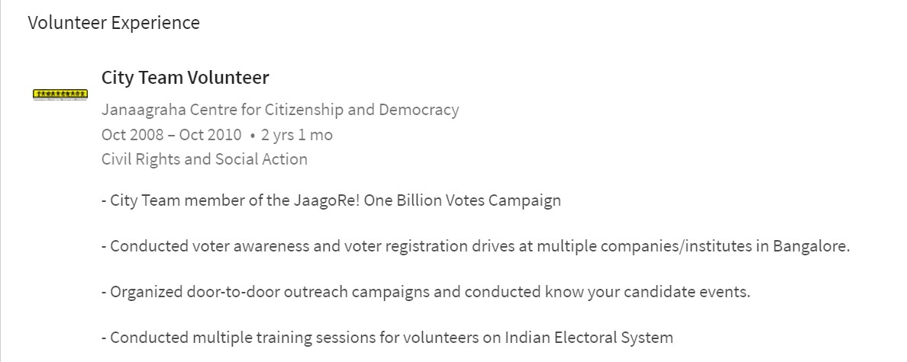
BACKGROUND: VOLUNTEER EXPERIENCE
Share the causes you care about and organizations you volunteer for in this section. Helps you stand out
from the crowd!

Slide 12
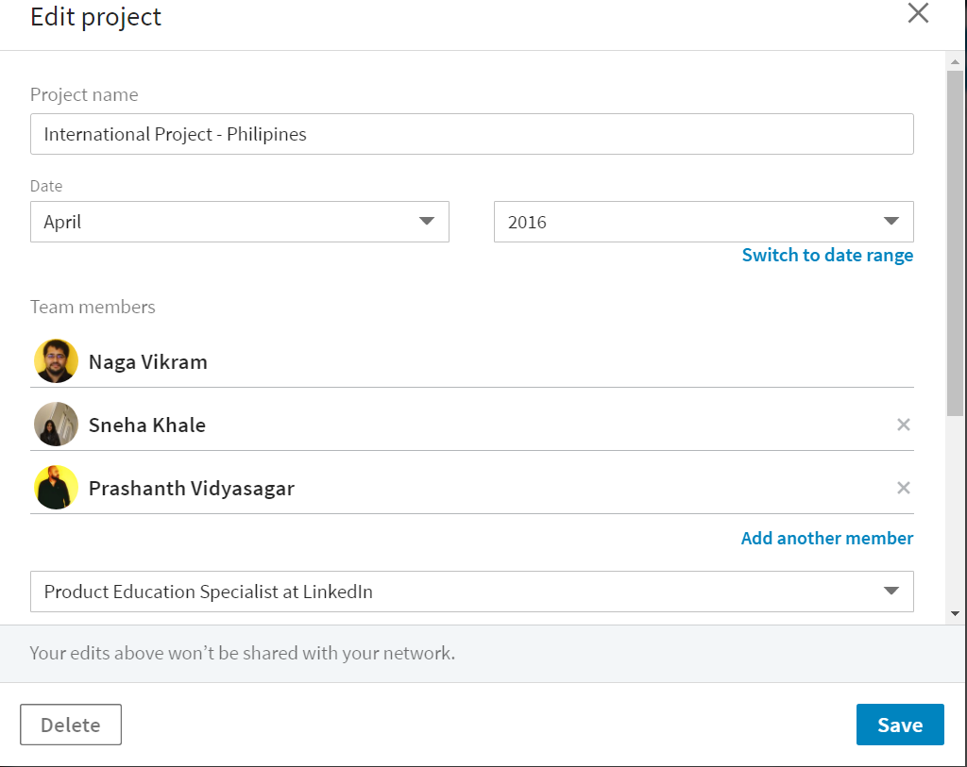
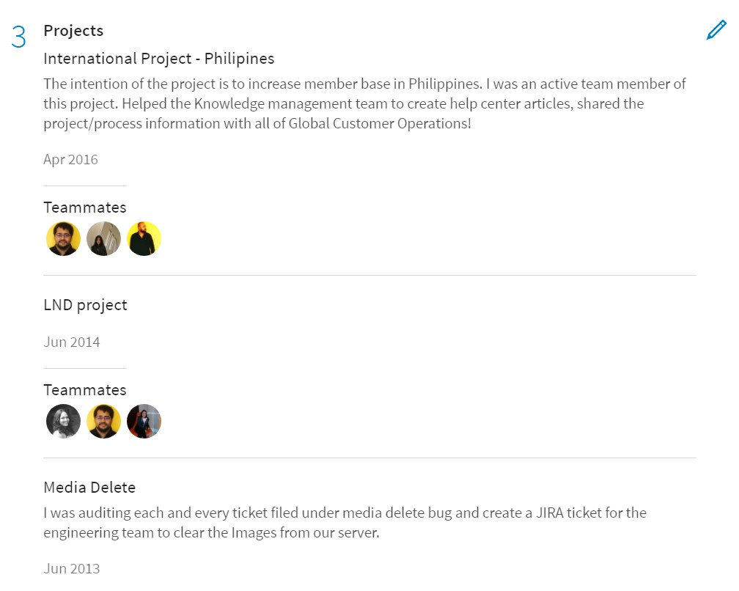
ACCOMPLISHMENTS: PROJECTS
You can add and edit multiple sections under projects right from the title to adding multiple team
members. Go ahead and showcase the real team player in you!

Slide 13
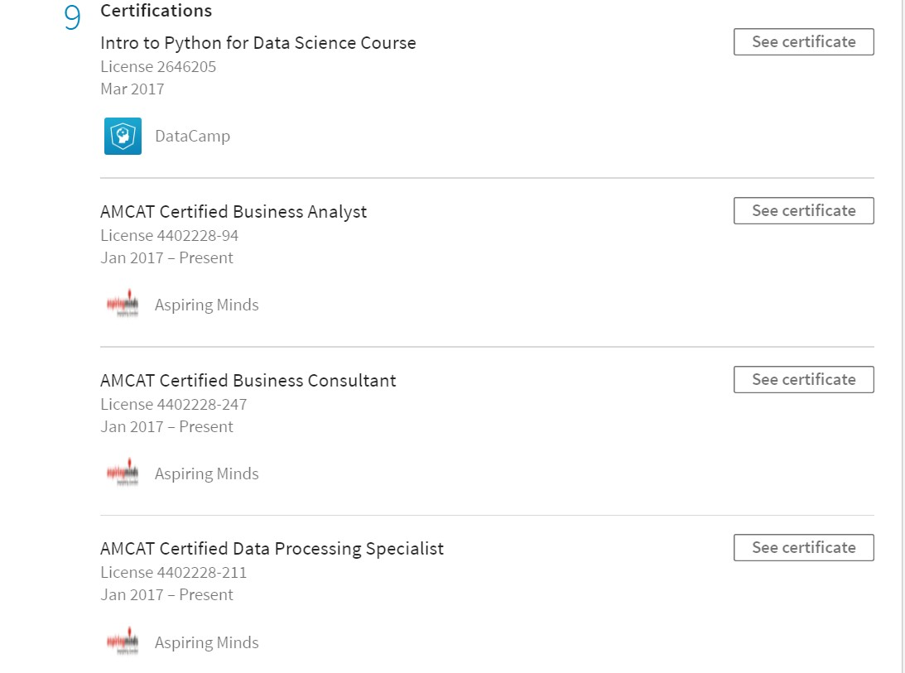
ACCOMPLISHMENTS: CERTIFICATIONS
Because nothing says you’re more qualified than a string of certifications in your line of study or in that
specialization you’re looking to pursue.

Slide 14
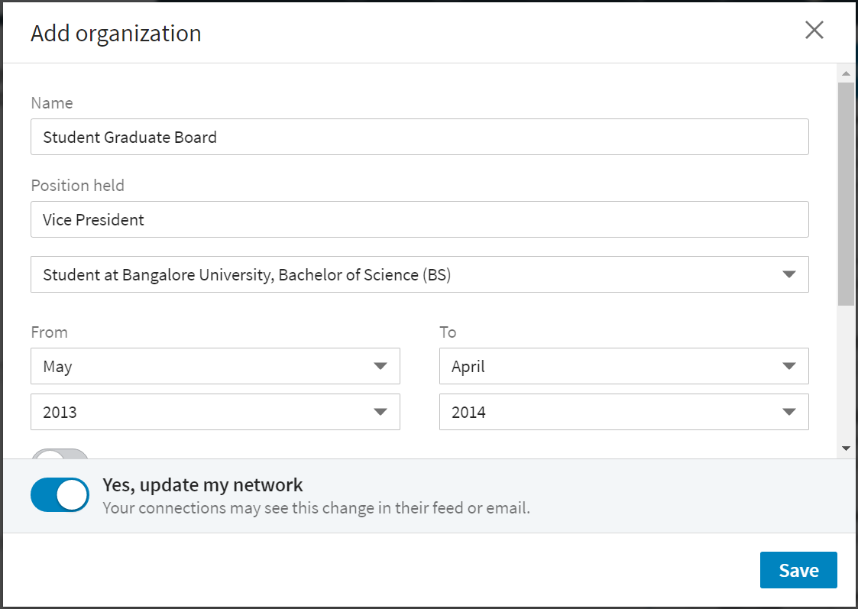
ACCOMPLISHMENTS: ORGANIZATIONS
This IS where you add positions held in college under various clubs and student organizations!

Slide 15
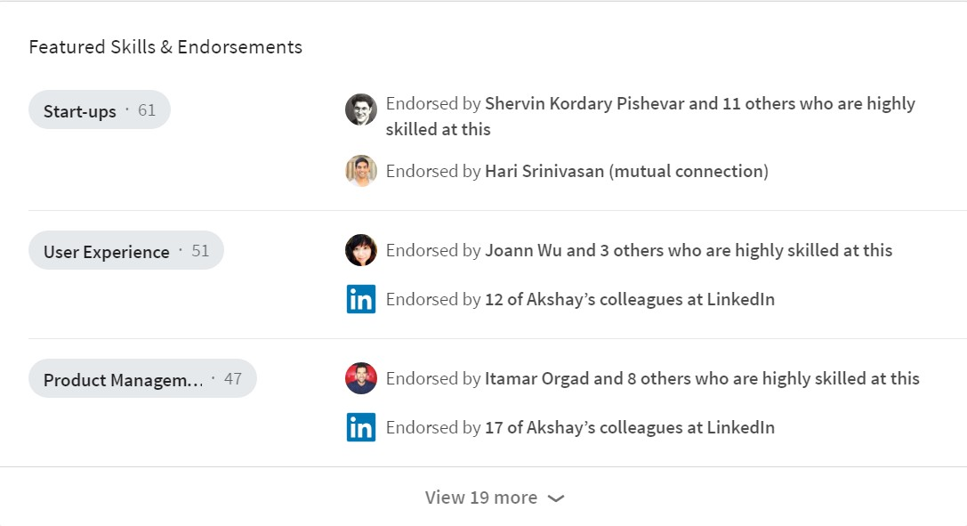
SKILLS AND ENDORSEMENTS
What better way to show that you’re the right person for the job than through adding skills on your profile?
How do you back it up? With endorsements from your trusted network of connections on LinkedIn!

Slide 16
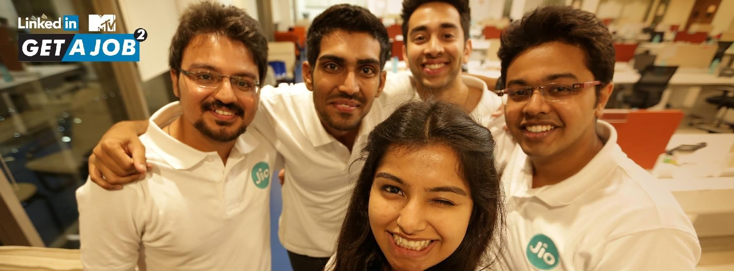
CONNECT WITH US!
https://www.linkedin.com/groups/8479345
https://in.linkedin.com/in/yashrajnayak

Slide 17
THANK YOU!

